Slide 1
MAKING SENSE OF
LABOUR MARKET INFORMATION
PART 1
Introduction to Labour Market Information (LMI)
FALL 2020

Slide 2
CONTENT OF THIS WEBINAR
Labour Market Information (LMI):
What is it?
It is important to whom? Why?
Job classification:
National Occupational Classification (NOC)
North American Industry Classification
System (NAICS)
Key factors impacting the labour market
LMI and Local Labour Market Planning

Slide 3
WHAT IS LABOUR MARKET INFORMATION (LMI)?
LMI is the information that we need individuals and organizations) to make decisions about the labour market. It is information and data about the supply and demand for labour within a certain labour market.
Source: Guide To Using Labour Market Information In Ontario, Ministry of Training, Colleges and Universities – 2005
LE MARCHÉ DU TRAVAIL

Slide 4
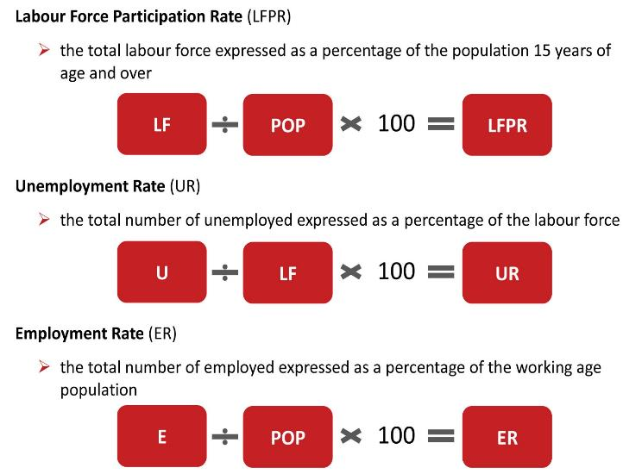
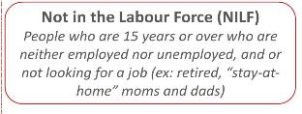
SOME COMMON DEFINITIONS
Source: Guide To Using Labour Market Information In Ontario, Ministry of Training, Colleges and Universities – 2005

Slide 5
Community and government (municipal, provincial and national):
to identify issues (needs, shortages).
to inform program planning and training projects, education and job creation.
to develop policies and regulations.
to evaluate the relevance of programs and services.
Educators:
to forecast student demand.
to develop curricular and course offerings.
to help students plan their careers.
Students making career choices:
to make informed decisions (professions, education).
to evaluate the occupations that fits best with their interests and abilities.
to evaluate the occupations and industries where there are employment opportunities.
WHO USES LMI?
Employers:
to help them recruit workers, establish working conditions, plan human resources needs (present and future).
to plan development and growth of their business.
Job seekers:
to find information on job opportunities, skill level requirements, working conditions.
to identify their training needs and effective job search strategies.

Slide 7
the national
occupational
classification
(noc)
The system of occupation classification that Governments commonly use is the National Occupational Classification (NOC).
The NOC is updated in partnership with Statistics Canada according to 5-year Census cycles. It is based on extensive occupational research and consultations conducted across the country, reflecting the evolution of the Canadian labour market.
It organize over 30,000 job titles into 520 occupational group descriptions.
A four-digit code, called the “NOC code” identifies the occupation. Each digit of this code reflects an important trait of the occupation it represents.
The two major attributes of jobs used as classification criteria in developing the NOC are skill level and skill type. Other factors, such as industry and occupational mobility, are also taken in consideration.
7

Slide 8
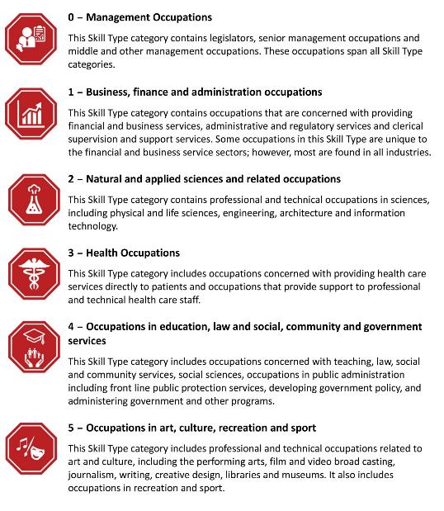
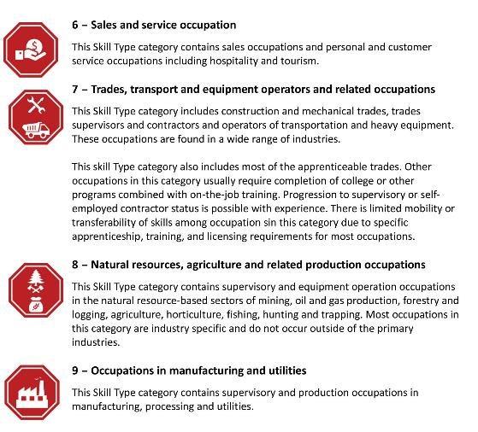

Slide 9
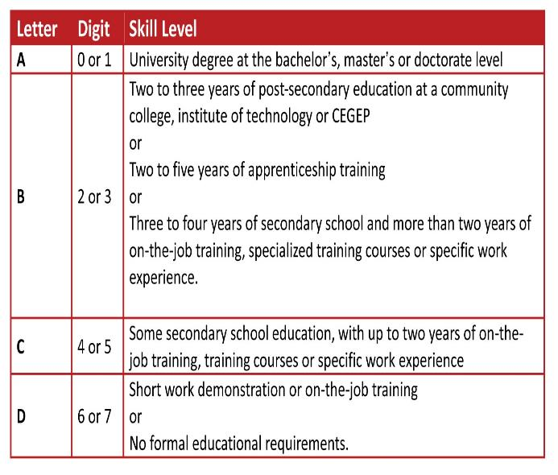
EXAMPLES
9231
The first digit indicates the Skill Type 9,
Occupations Unique to Processing, Manufacturing and Utilities
The second digit indicates the Skill Level B
– – – – – – – – –
6443
The first digit indicates the Skill Type 6,
Sales and Service Occupations
The second digit indicates the Skill Level C
– – – – – – – – –
0212
The first digit 0 always indicates Senior Management Occupations
The second digit indicates the Skill Type 2,
Natural and Applied Sciences and Related Occupations

Slide 10
North american
Industry
classification
System (naics)
The North American Industry Classification System (NAICS) is an industry classification system established by the statistical agencies of Canada, Mexico and the United States.
NAICS is designed to provide common definitions of the industrial structure of the three countries and a common statistical framework to facilitate the analysis of the three economies.
The economic transactors for which NAICS is designed are businesses and other organizations engaged in the production of goods and services.
The classification is revised every five years to ensure that it continues to reflect the changing structure of the economy.
10

Slide 11
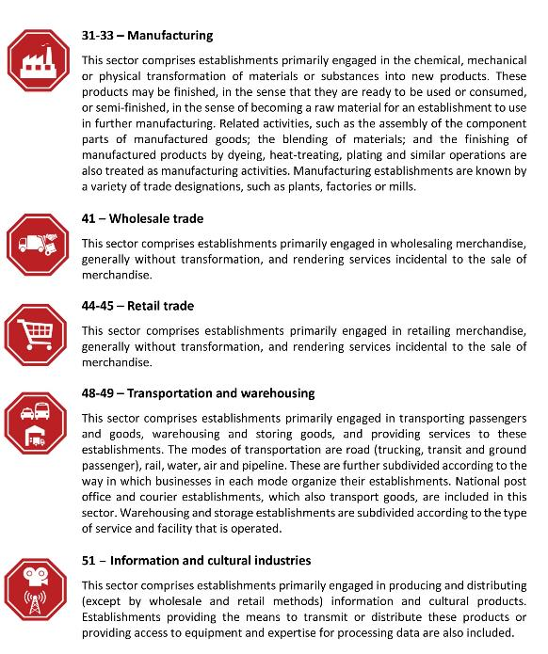
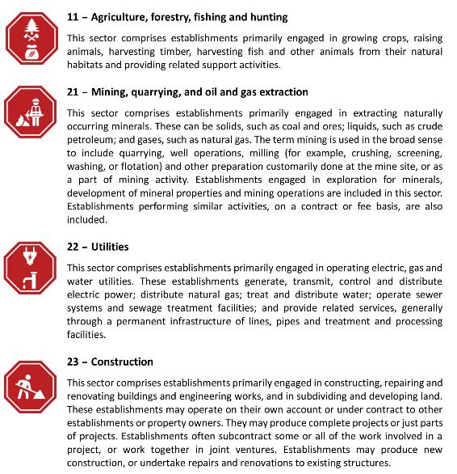
The NAICS consists of 20 sectors, 102 subsectors, 322 industry groups, 708 industries and 923 national industries.

Slide 12
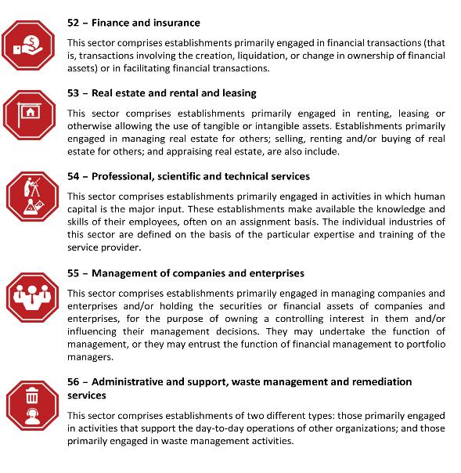
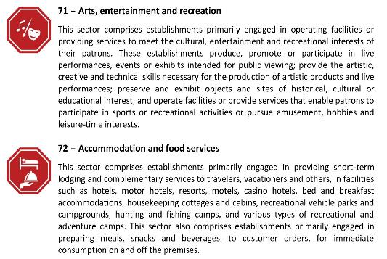
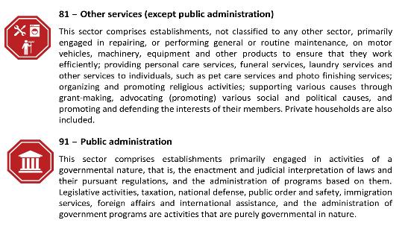

Slide 13
The NAICS numbering system that has been adopted is a six-digit code. The first two digits designate the sector, the third digit designates the subsector, the fourth digit designates the industry group, and the fifth digit designates the industry. The sixth digit is used to designate national industries.
81
Other services (except public administration)
811
Repair and maintenance
8111
Automotive repair and maintenance
81111
Automotive mechanical and electrical repair and maintenance
811111
A couple of
concrete examples
General automotive repair
11
Agriculture, forestry, fishing and hunting
111
Crop Production
1112
Vegetables and melon farming
11121
Vegetables and melon farming
111211
Source: http://www23.statcan.gc.ca/imdb/p3VD.pl?Function=getVD&TVD=307532
Potato farming

Slide 14
Key Factors Impacting the Local Labour Market
Changing demographics
An aging and declining population
Retirement of the last wave of the baby boomers
Youth out-migration
Low level of new comers
Shortages of qualified workers in many occupations
Increasing competition
Technology
The changing world of work.

Slide 15
LMI AND Local Labour Market PLANNING
LMI provides an evidence-base to ensure that the development and implementation of programs/services/interventions is informed by the most current, relevant and reliable data.
Data (evidence) and local knowledge, allow us to collectively identify:
local labour market demand challenges and opportunities
local labour market supply challenges and opportunities
Look at how/if local programs and services align with those challenges and opportunities.

Slide 16
800-530-9176 or 705-362-5788 www.fnetb.com
info@fnetb.com

